Slide 1


Ecommerce Analysis
Presented by - Vishv Sonar

Slide 2

Objective
To perform data manipulation and solve analytical queries on an e-commerce dataset using both SQL and Python (Pandas). The aim of this project is to demonstrate practical skills in data cleaning, transformation, aggregation, and insight generation by applying both tools effectively to real-world business problems, rather than comparing them.

Slide 3
Problem Statement
Organizations often rely on multiple tools such as SQL databases and Python programming for data analysis. However, understanding when and how to use each tool effectively can be challenging. This project focuses on solving identical e-commerce data problems using both SQL queries and Python (Pandas) methods to evaluate their approaches, performance, and suitability for different analytical tasks such as sales calculation, customer behavior analysis, revenue trends, and advanced statistical operations.

Slide 4
Methodology
Dataset Understanding: Studied the structure, fields, and relationships among key tables such as Customers, Orders, Order Items, Products, Sellers, and Payments.
Problem Definition: Identified analytical questions covering basic metrics, intermediate aggregations, and advanced analytical scenarios.
Dual Implementation: Solved each problem using both SQL queries and Python (Pandas) to enable direct comparison of approaches.
Data Preparation: Performed data cleaning, datatype conversions, joins, filtering, grouping, and aggregations in both environments.
Comparative Analysis: Evaluated differences in syntax, execution style, flexibility, and efficiency between SQL and Python solutions.
Result Validation: Cross-checked outputs from both methods to ensure accuracy and consistency of results.
Insight Extraction: Interpreted results to derive meaningful business insights related to sales trends, customer behavior, and revenue patterns.

Slide 5

Basic Problems
Objective-Objective: Extract fundamental insights from the dataset

Slide 6
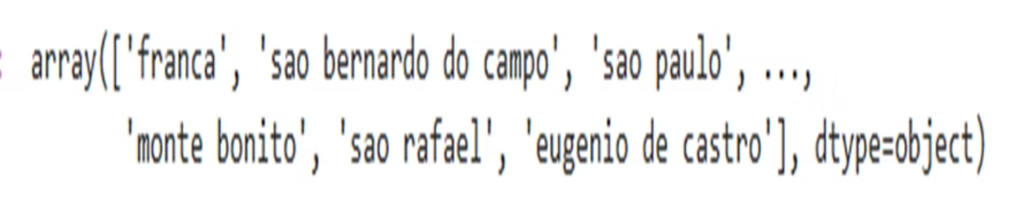
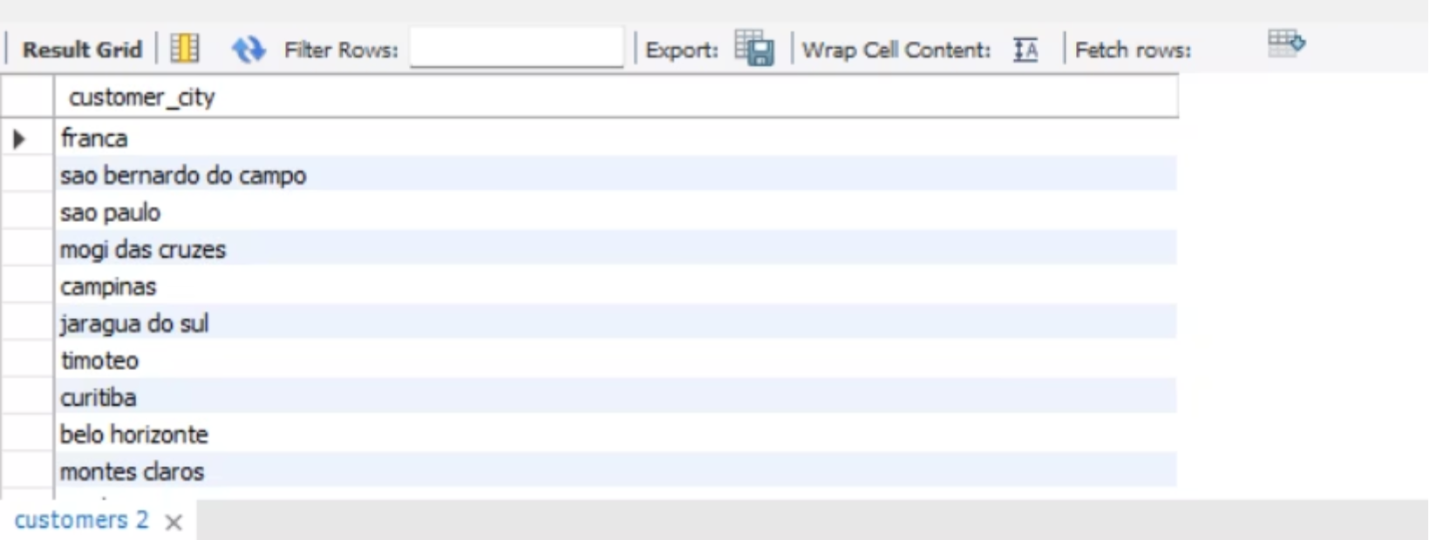
1. List of all unique cities where customers are located
CODE : Python
CODE : SQL
customers['customer_city'].unique()
SELECT DISTINCT
customer_city
FROM
customers;

Slide 7
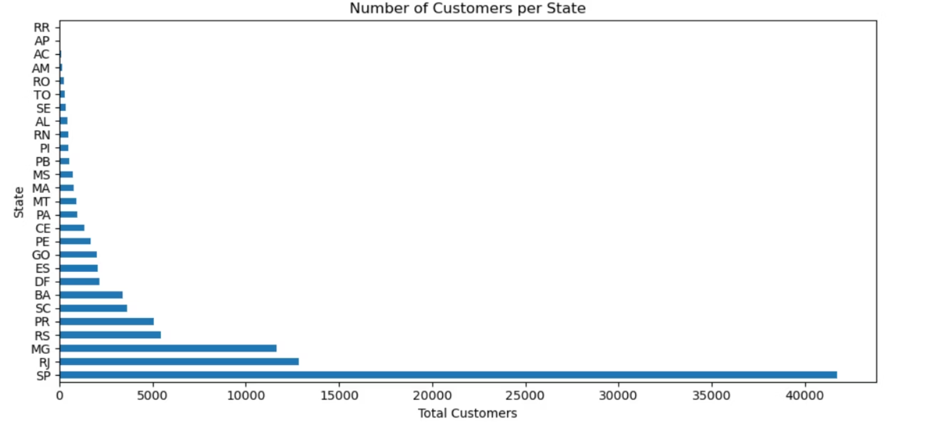
1. List of all unique cities where customers are located
CODE : Python
import matplotlib.pyplot as plt plt.figure(figsize=(10,5)) state_counts.plot(kind='barh') plt.title('Number of Customers per State') plt.xlabel('Total Customers') plt.ylabel('State') plt.tight_layout() plt.show()

Slide 8
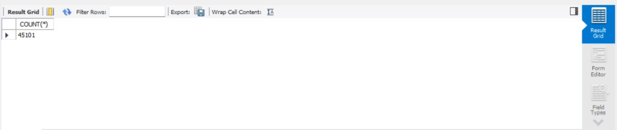
2. Count number of orders placed in 2017
CODE : Python
CODE : SQL
orders_2017 =
orders[
orders['order_purchase_timestamp'].astype(str).str.startswith('2017')
]len(orders_2017)
SELECT COUNT(*)
FROM orders
WHERE order_purchase_timestamp LIKE '2017%';

Slide 9
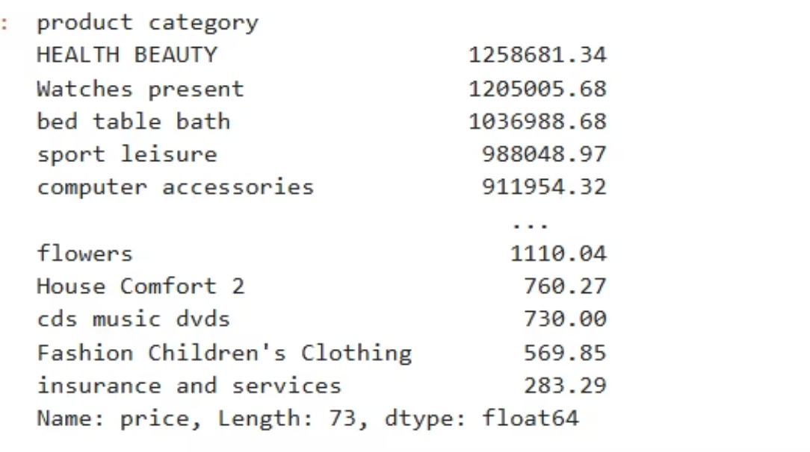
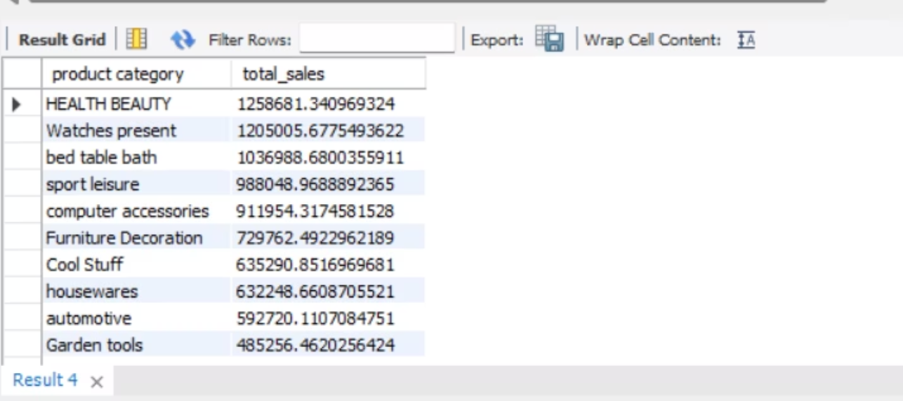
3. Total Sales Per Category
CODE : Python
CODE : SQL
merged = order_items.merge(products, on='product_id')sales_category = merged.groupby('product category')['price'].sum().sort_values(ascending=False)sales_category plt.figure(figsize=(8,8)) sales_category.head(8).plot(kind='pie', autopct='%1.1f%%') plt.title('Top Categories by Sales Share') plt.ylabel('') plt.show()
HOW COLUMNS FROM products;SELECT p.`product category`, SUM(oi.price) AS total_salesFROM order_items oi JOIN products p ON oi.product_id = p.product_idGROUP BY p.`product category`ORDER BY total_sales DESC;

Slide 10
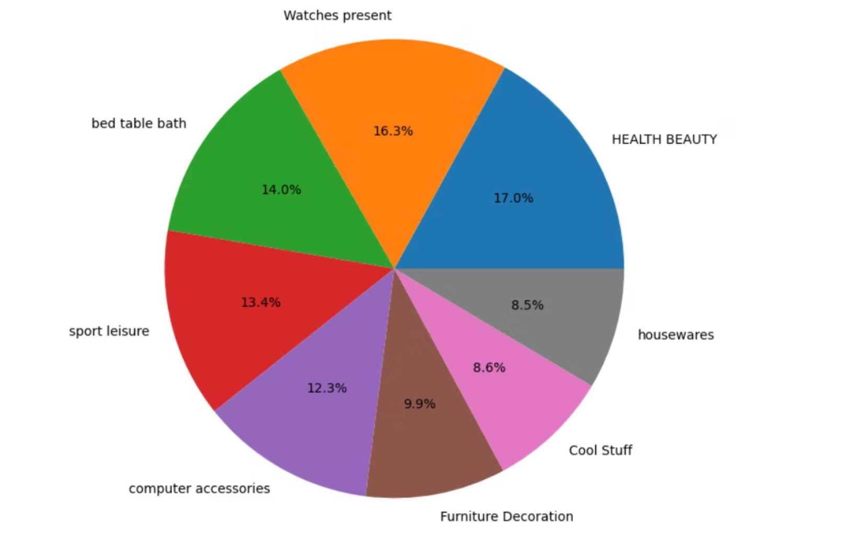
3.Total Sales Per Category
CODE : Python
plt.figure(figsize=(8,8)) sales_category.head(8).plot(kind='pie', autopct='%1.1f%%') plt.title('Top Categories by Sales Share') plt.ylabel('') plt.show()

Slide 11
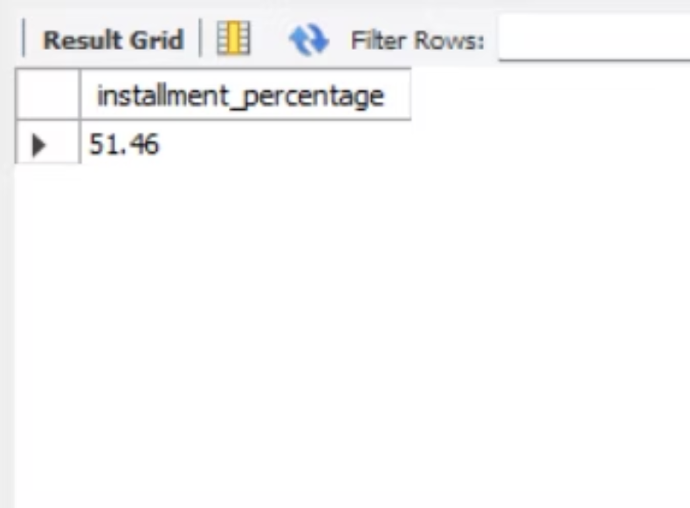
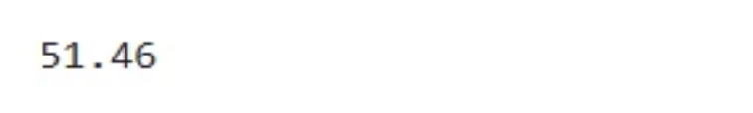
4. Calculate the percentage of orders that were paid in installments.
CODE : Python
CODE : SQL
total_orders = payments['order_id'].nunique() installment_orders = payments[payments['payment_installments'] > 1]['order_id'].nunique() percentage = (installment_orders / total_orders) * 100 round(percentage, 2)
SELECT ROUND((COUNT(DISTINCT CASE
WHEN payment_installments > 1 THEN order_id
END) * 100.0) / COUNT(DISTINCT order_id),
2) AS installment_percentage
FROM order_payments;

Slide 12
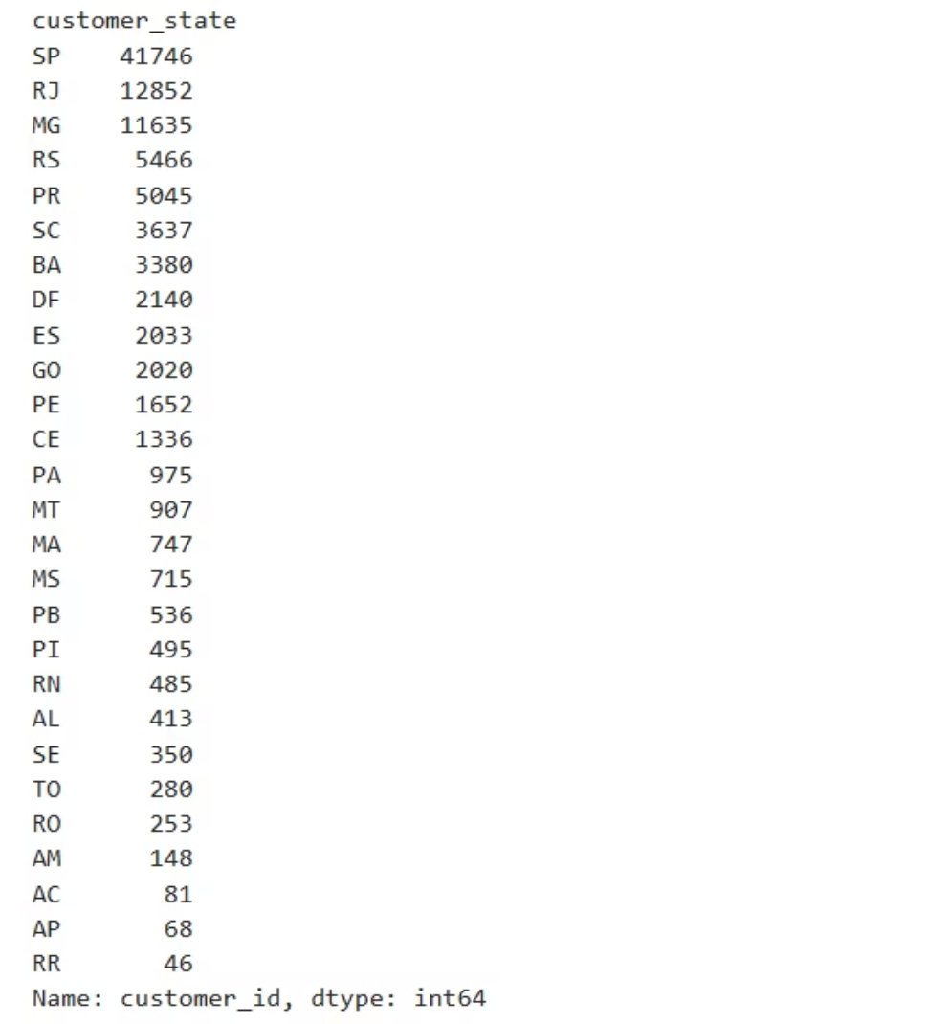
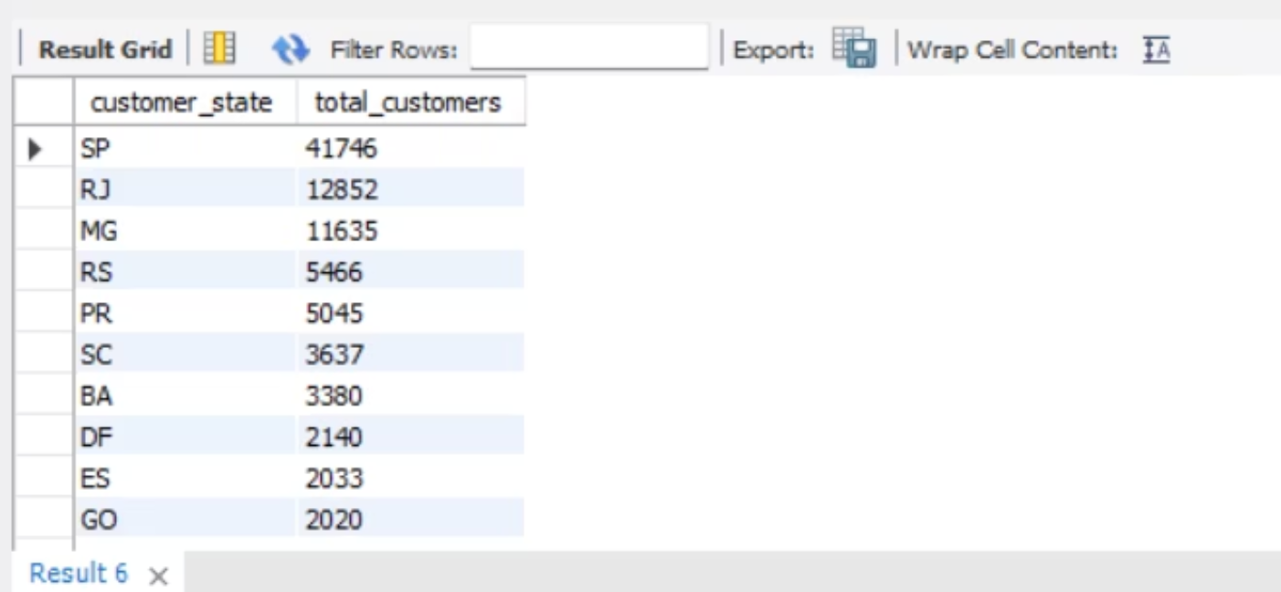
5. Count the number of customers from each state
CODE : Python
CODE : SQL
customers.groupby('customer_state')['customer_id'].count().sort_values(ascending=False)
SELECT customer_state,
COUNT(customer_id) AS total_customers
FROM customers
GROUP BY customer_state
ORDER BY total_customers DESC;

Slide 13
Intermediate Problems
Objective: Dive deeper into sales and order trends.

Slide 14
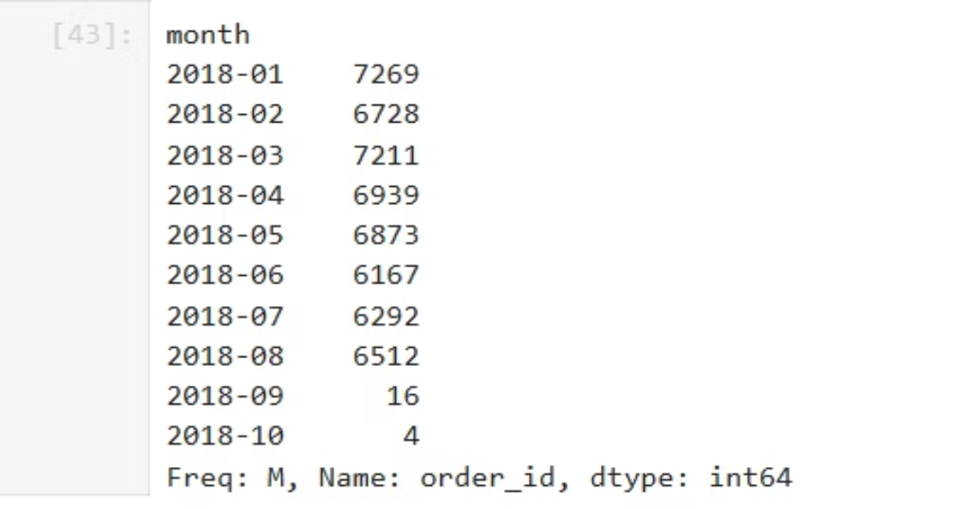
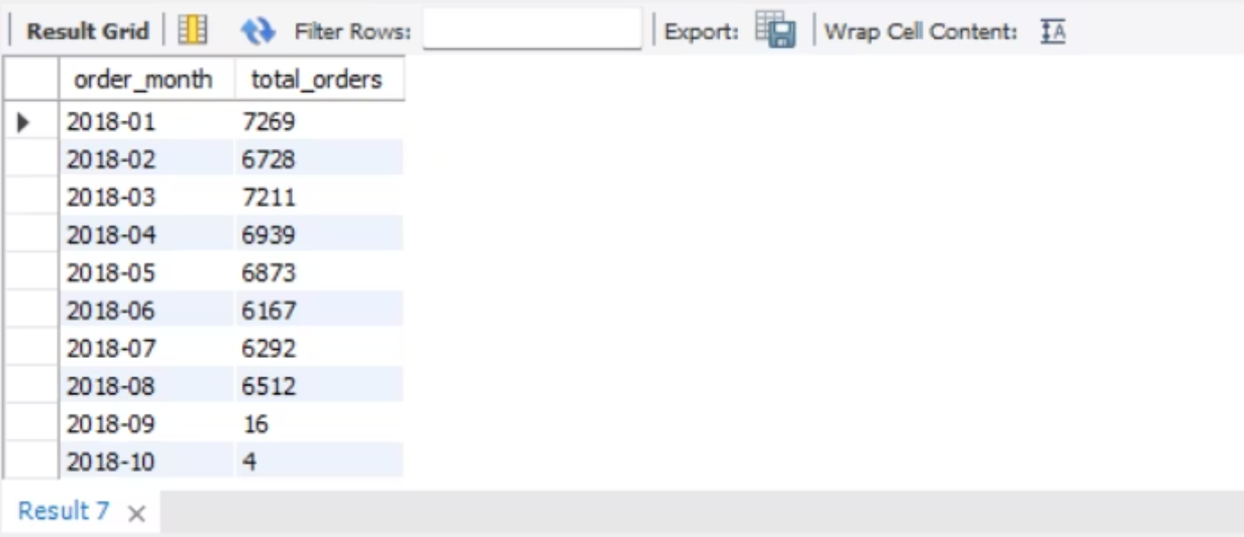
1. Number of Orders Per Month in 2018
CODE : Python
CODE : SQL
orders['order_purchase_timestamp'] = pd.to_datetime(
orders['order_purchase_timestamp'],
format='%Y-%m-%d %H.%M.%S')
orders_2018 = orders[orders['order_purchase_timestamp'].dt.year == 2018].copy()
orders_2018.loc[:, 'month'] = orders_2018['order_purchase_timestamp'].dt.to_period('M')
orders_2018.groupby('month')['order_id'].count()
SELECT
DATE_FORMAT(order_purchase_timestamp, '%Y-%m') AS order_month,
COUNT(order_id) AS total_orders
FROM
orders
WHERE
YEAR(order_purchase_timestamp) = 2018
GROUP BY order_month
ORDER BY order_month;

Slide 15
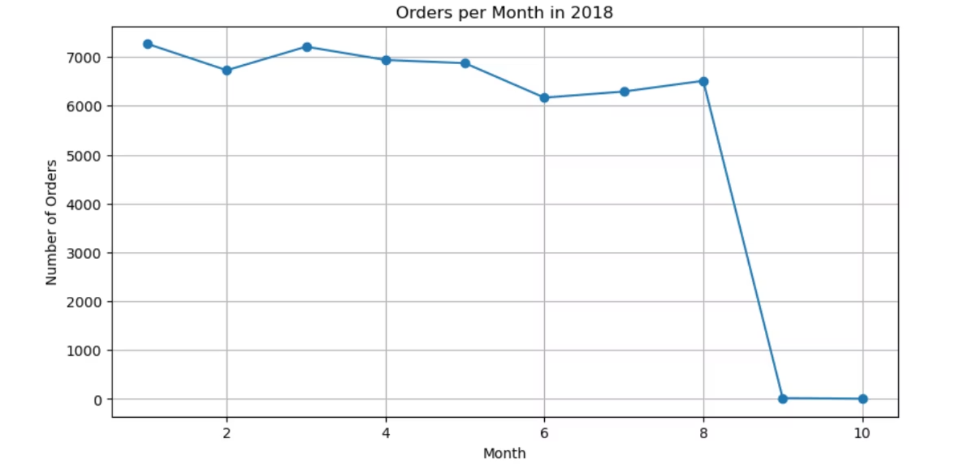
1. Number of Orders Per Month in 2018
CODE : Python
orders['order_purchase_timestamp'] = pd.to_datetime(orders['order_purchase_timestamp']) orders_2018 = orders[orders['order_purchase_timestamp'].dt.year == 2018] monthly_orders = orders_2018.groupby( orders_2018['order_purchase_timestamp'].dt.month ).size() plt.figure(figsize=(10,5)) monthly_orders.plot(kind='line', marker='o') plt.title('Orders per Month in 2018') plt.xlabel('Month') plt.ylabel('Number of Orders') plt.grid(True) plt.show()

Slide 16
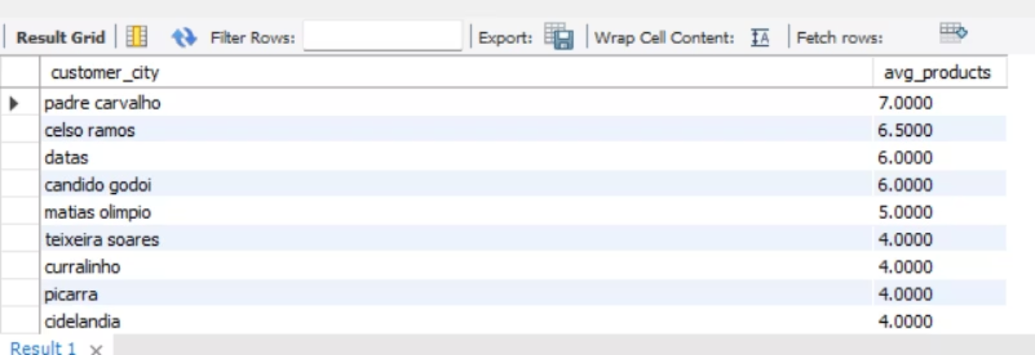
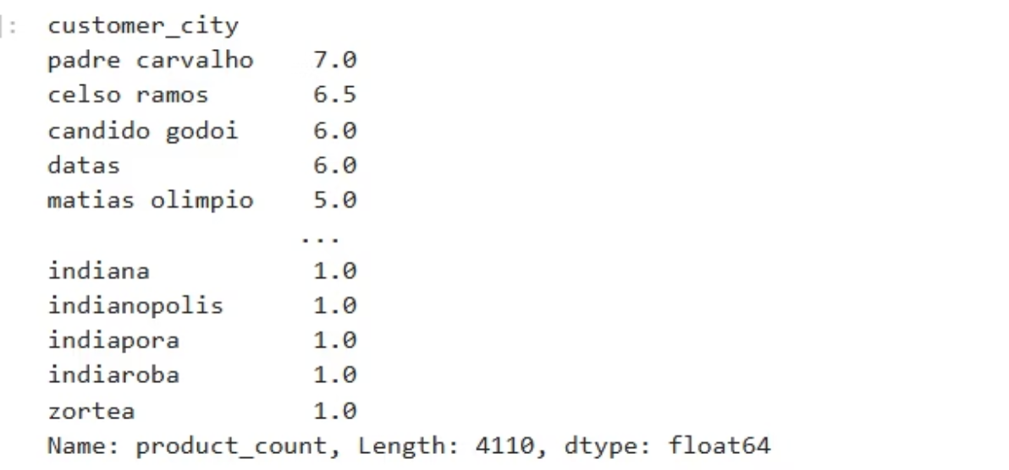
2. Average Number of Products per Order by Customer City
CODE : Python
CODE : SQL
# Count products per orderorder_counts = (
order_items
.groupby('order_id')['product_id']
.count()
.reset_index(name='product_count'))
# Merge with ordersmerged = order_counts.merge(orders, on='order_id', how='left')
# Merge with customersmerged = merged.merge(customers, on='customer_id', how='left')
# Final resultavg_products_city = (
merged
.groupby('customer_city')['product_count']
.mean()
.sort_values(ascending=False))
avg_products_city
SELECT c.customer_city, AVG(order_product_count) AS avg_products FROM (SELECT order_id, COUNT(product_id) AS order_product_count FROM order_items GROUP BY order_id) oi JOIN orders o ON oi.order_id = o.order_id JOIN customers c ON o.customer_id = c.customer_id GROUP BY c.customer_city;

Slide 17
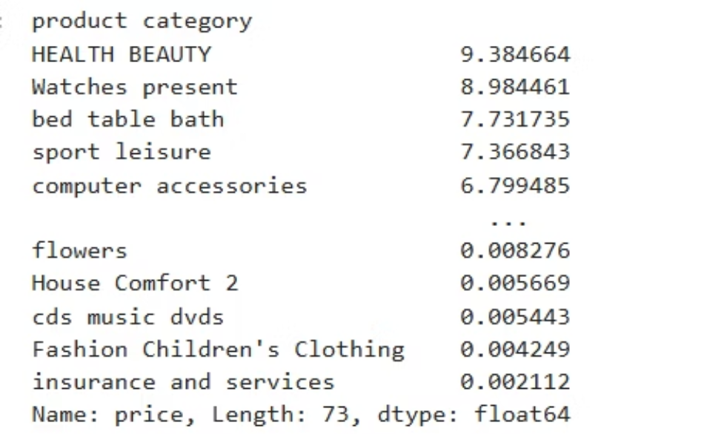
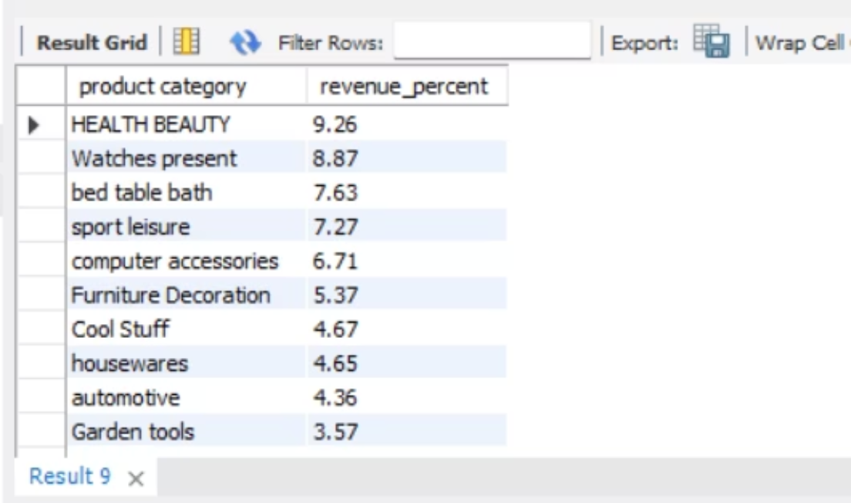
3. Percentage of Total Revenue by Product Category
CODE : Python
CODE : SQL
merged = order_items.merge(products,
on='product_id', how='left')
category_revenue = (
merged.groupby('product category')['price']
.sum())
percentage = (category_revenue /
category_revenue.sum()) * 100percentage =
percentage.sort_values(ascending=False)percentage
SELECT p.`product category`, ROUND(SUM(oi.price) * 100 / (SELECT SUM(price) FROM order_items), 2) AS revenue_percentFROM order_items oi JOIN products p ON oi.product_id = p.product_idGROUP BY p.`product category`ORDER BY revenue_percent DESC;

Slide 18
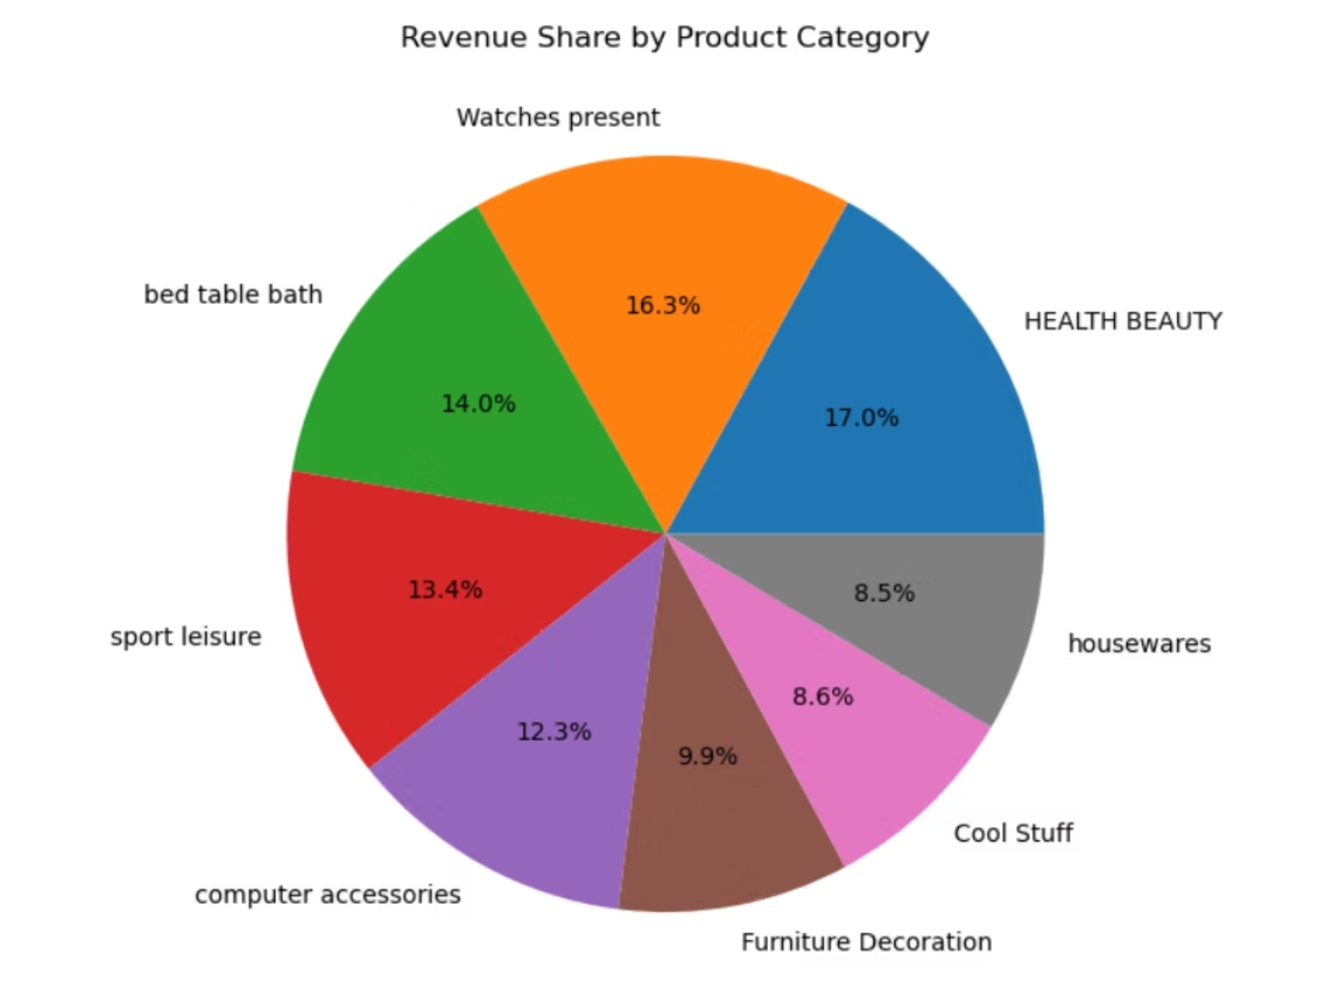
3. Percentage of Total Revenue by Product Category
CODE : Python
plt.figure(figsize=(7,7))
percentage.head(8).plot(kind='pie', autopct='%1.1f%%')
plt.title('Revenue Share by Product Category')
plt.ylabel('')
plt.show()

Slide 19
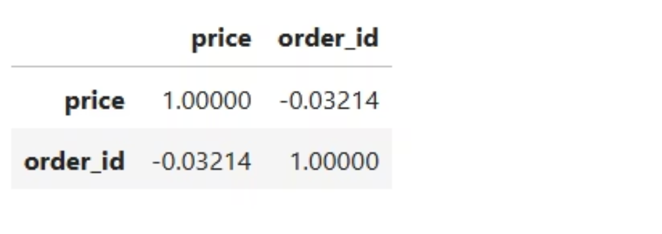
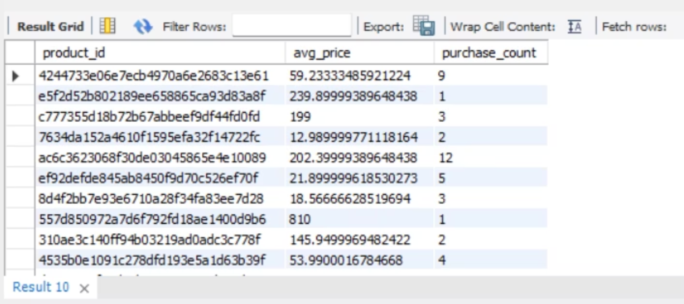
4. Correlation Between Price and Purchase Count
CODE : Python
CODE : SQL
product_stats =
order_items.groupby('product_id').agg({
'price': 'mean',
'order_id': 'count'})product_stats.corr()
SELECT
product_id,
AVG(price) AS avg_price,
COUNT(order_id) AS purchase_count
FROM
order_items
GROUP BY product_id;

Slide 20
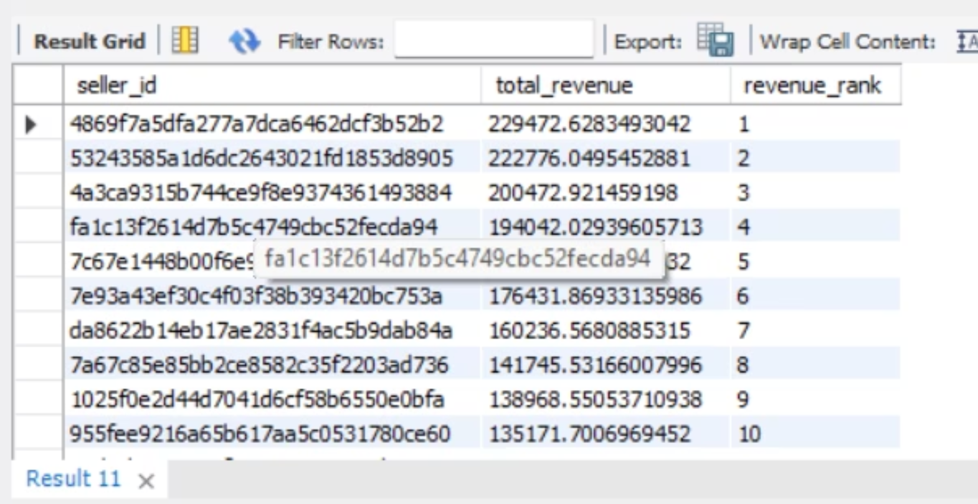
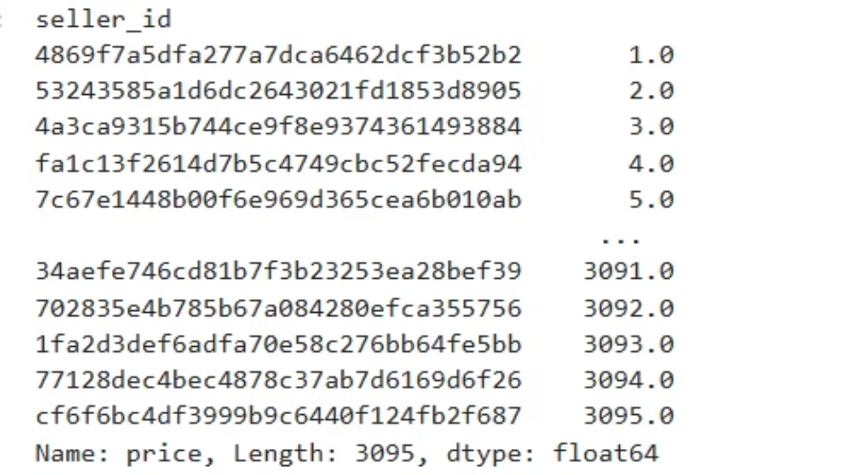
5. Total Revenue per Seller & Ranking
CODE : Python
CODE : SQL
seller_revenue =
order_items.groupby('seller_id')
['price'].sum().sort_values(ascending=False)seller_revenue.rank(ascending=False)
SELECT seller_id, SUM(price) AS total_revenue, RANK() OVER (ORDER BY SUM(price) DESC) AS revenue_rankFROM order_itemsGROUP BY seller_id;

Slide 21
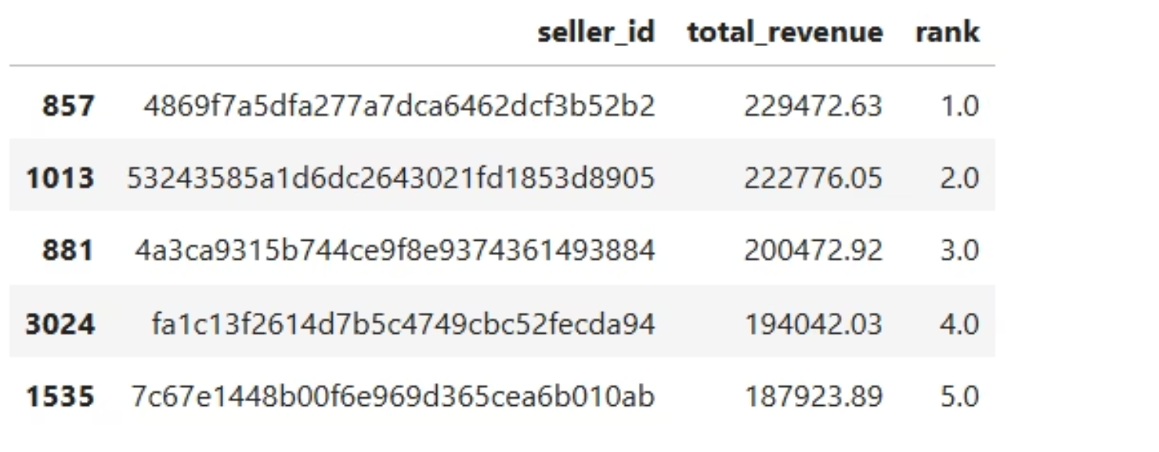
5.Total Revenue per Seller & Ranking
CODE : Python
seller_revenue = order_items.groupby('seller_id')['price'].sum().reset_index() seller_revenue.columns = ['seller_id', 'total_revenue'] seller_revenue['rank'] = seller_revenue['total_revenue'] \ .rank(method='dense', ascending=False) seller_revenue = seller_revenue.sort_values('total_revenue', ascending=False) seller_revenue.head()
Total Revenue

Slide 22
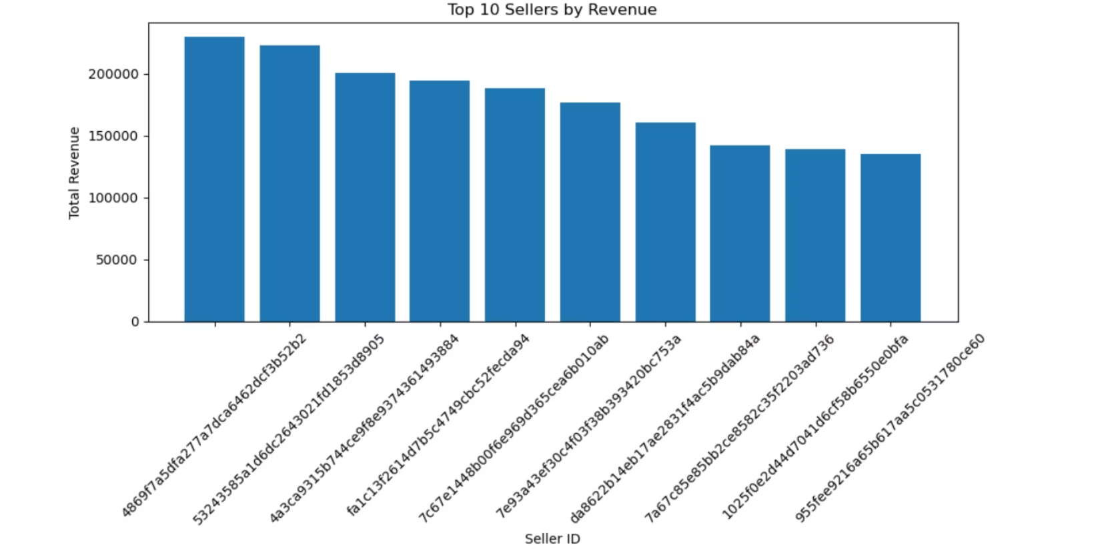
5. Total Revenue per Seller & Ranking
CODE : Python
import matplotlib.pyplot as plt top10 = seller_revenue.head(10) plt.figure(figsize=(10,6)) plt.bar(top10['seller_id'], top10['total_revenue']) plt.title('Top 10 Sellers by Revenue') plt.xlabel('Seller ID') plt.ylabel('Total Revenue') plt.xticks(rotation=45) plt.tight_layout() plt.show()

Slide 23
Advance Problems
Objective: Generate strategic and customer-centric insights.

Slide 24
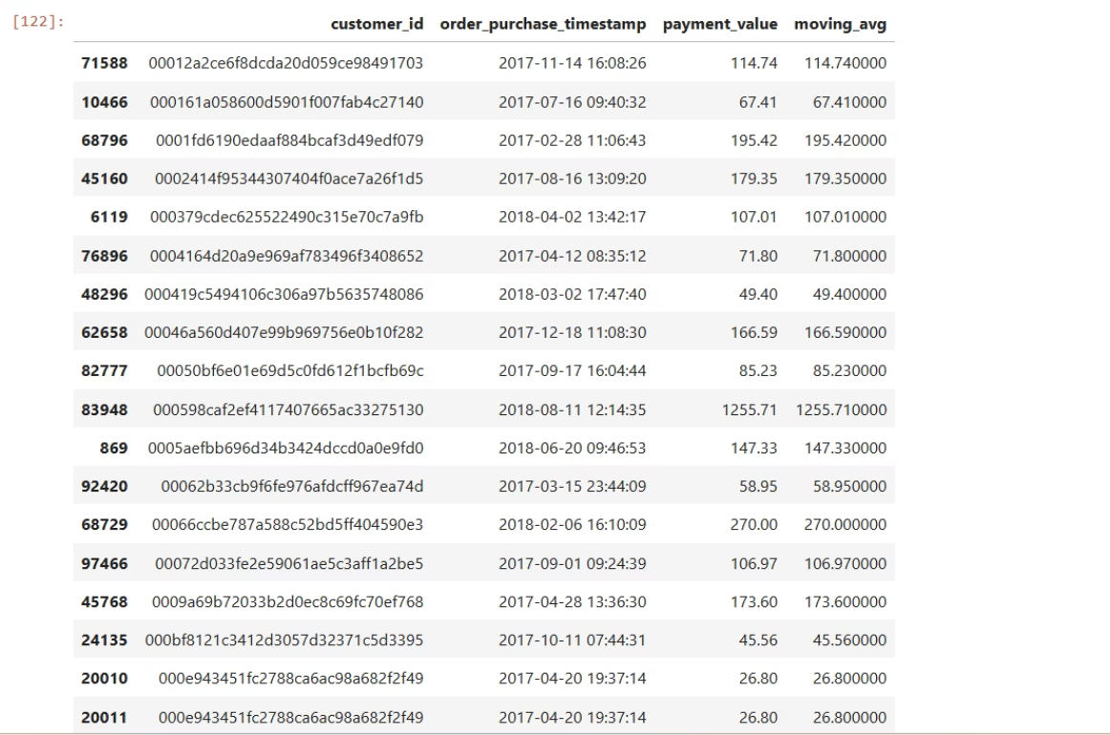
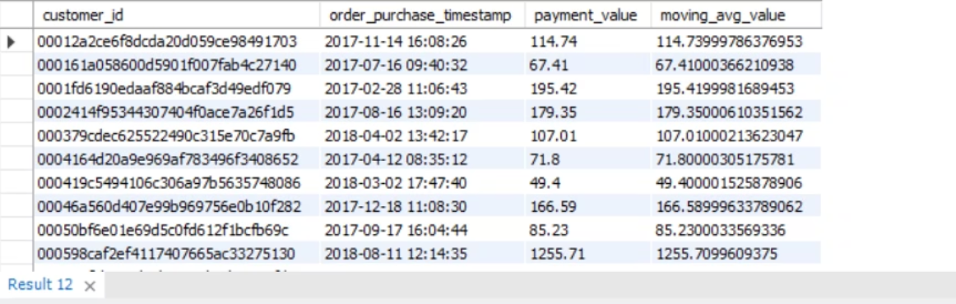
1.Moving Average of Order Value per Customer.
CODE : Python
CODE : SQL
df = orders.merge(order_payments, on='order_id', how='left')df.head()
df = df.sort_values(['customer_id', 'order_purchase_timestamp'])
df['moving_avg'] = (
df.groupby('customer_id')['payment_value']
.rolling(3, min_periods=1)
.mean()
.reset_index(level=0, drop=True))
df[['customer_id','order_purchase_timestamp','payment_value','moving_avg']].head(20)
SELECT
customer_id,
order_purchase_timestamp,
payment_value,
AVG(payment_value) OVER (
PARTITION BY customer_id
ORDER BY order_purchase_timestamp
ROWS BETWEEN 2 PRECEDING AND CURRENT ROW
) AS moving_avg_value
FROM orders o
JOIN order_payments p
ON o.order_id = p.order_id;

Slide 25
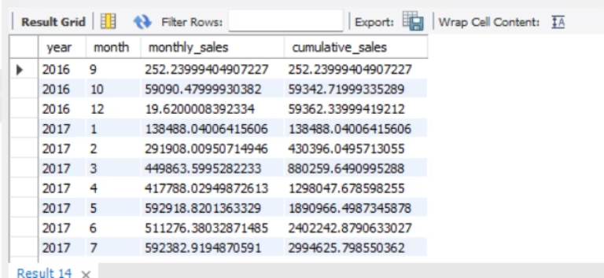
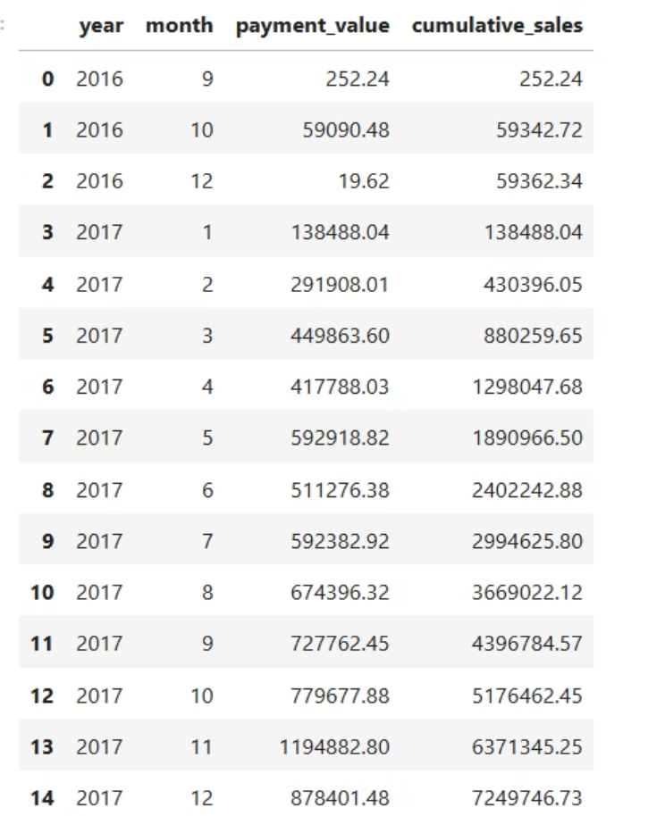
2.Calculate the cumulative sales per month for each year
CODE : Python
CODE : SQL
df = orders.merge(order_payments, on='order_id', how='left')
df['year'] = df['order_purchase_timestamp'].dt.year
df['month'] = df['order_purchase_timestamp'].dt.month
df[['order_purchase_timestamp','year','month']].head()
monthly_sales = (
df.groupby(['year','month'])['payment_value']
.sum()
.reset_index()
)
monthly_sales = monthly_sales.sort_values(['year','month'])
monthly_sales['cumulative_sales'] = (
monthly_sales.groupby('year')['payment_value']
.cumsum()
)
monthly_sales.head()
FROM (
SELECT
YEAR(o.order_purchase_timestamp) AS year,
MONTH(o.order_purchase_timestamp) AS month,
SUM(p.payment_value) AS monthly_sales
FROM orders o
JOIN order_payments p
ON o.order_id = p.order_id
GROUP BY year, month
) t
ORDER BY year, month;

Slide 26
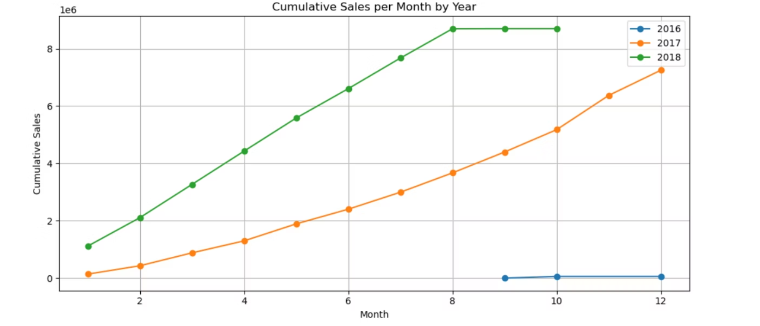
2.Calculate the cumulative sales per month for each year
CODE : Python
plt.figure(figsize=(10,5)) for year in monthly_sales['year'].unique(): data = monthly_sales[monthly_sales['year'] == year] plt.plot(data['month'], data['cumulative_sales'], marker='o', label=year) plt.title('Cumulative Sales per Month by Year') plt.xlabel('Month') plt.ylabel('Cumulative Sales') plt.legend() plt.grid(True) plt.tight_layout() plt.show()

Slide 27
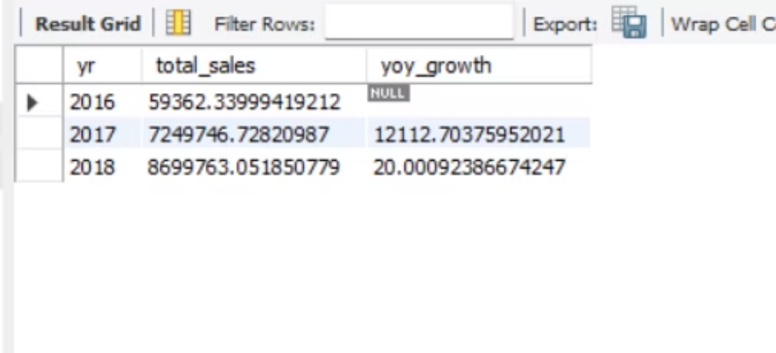
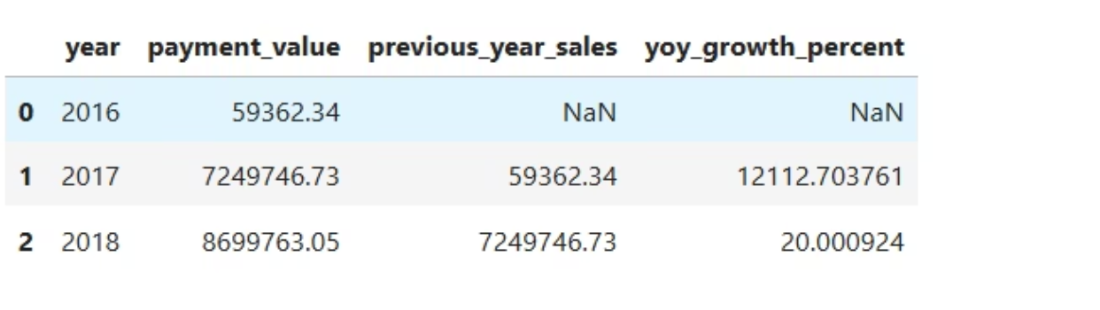
3.Year-over-Year Growth Rate
CODE : Python
CODE : SQL
yearly_sales = (
df.groupby('year')['payment_value']
.sum()
.reset_index())
yearly_sales
yearly_sales = yearly_sales.sort_values('year')
yearly_sales['previous_year_sales'] = yearly_sales['payment_value'].shift(1)
yearly_sales['yoy_growth_percent'] = (
(yearly_sales['payment_value'] - yearly_sales['previous_year_sales'])
/ yearly_sales['previous_year_sales']) * 100
yearly_sales
SELECT yr, total_sales, (total_sales - LAG(total_sales) OVER (ORDER BY yr)) /
LAG(total_sales) OVER (ORDER BY yr) * 100 AS yoy_growth
FROM yearly;

Slide 28
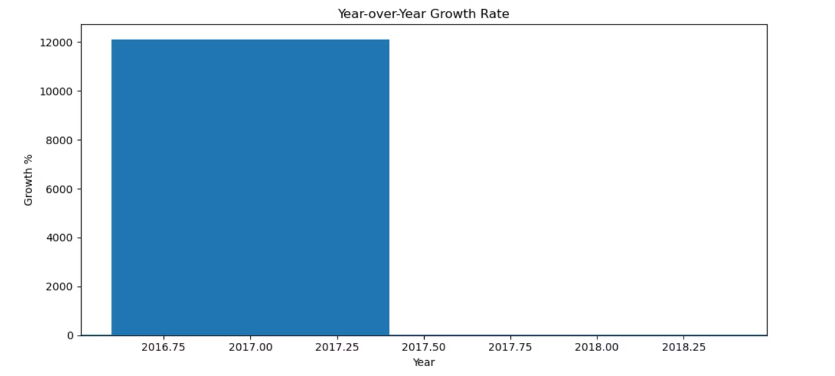
3.Year-over-Year Growth Rate
CODE : Python
plt.figure(figsize=(10,5)) plt.bar(yearly_sales['year'], yearly_sales['yoy_growth_percent']) plt.title('Year-over-Year Growth Rate') plt.xlabel('Year') plt.ylabel('Growth %') plt.axhline(0) plt.tight_layout() plt.show()

Slide 29
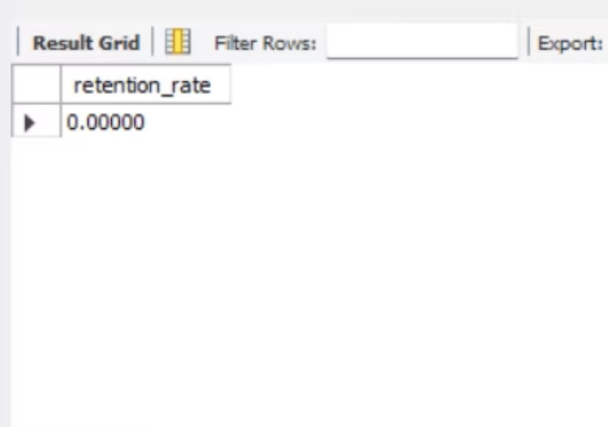
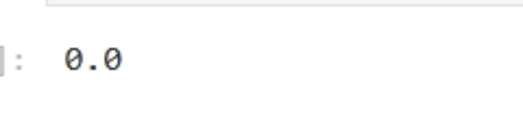
4. Customer Retention Rate (6 Months)
CODE : Python
CODE : SQL
first_purchase = (
df.groupby('customer_id')['order_purchase_timestamp']
.min()
.reset_index())
first_purchase.columns = ['customer_id', 'first_purchase_date']
merged = df.merge(first_purchase, on='customer_id', how='left')
repeat_orders = merged[
(merged['order_purchase_timestamp'] > merged['first_purchase_date']) &
(merged['order_purchase_timestamp'] <=
merged['first_purchase_date'] + pd.DateOffset(months=6))]
total_customers = first_purchase['customer_id'].nunique()
repeat_customers = repeat_orders['customer_id'].nunique()
# Count customers
total_customers = first_purchase['customer_id'].nunique()
repeat_customers = repeat_orders['customer_id'].nunique()
# Retention %
retention_rate = (repeat_customers / total_customers) * 100
round(retention_rate, 2)
SELECT COUNT(DISTINCT r.customer_id) * 100.0 /
COUNT(DISTINCT f.customer_id) AS retention_rate
FROM first_purchase f
LEFT JOIN repeat_purchase r
ON f.customer_id = r.customer_id;

Slide 30
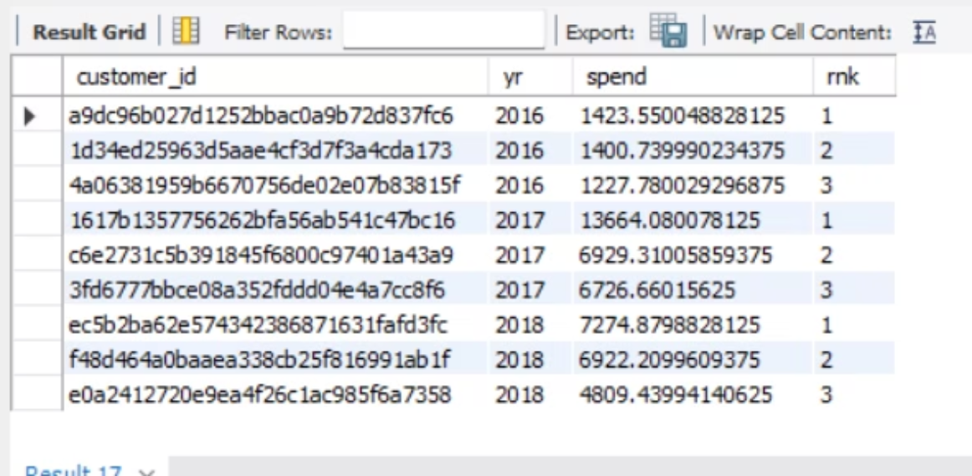
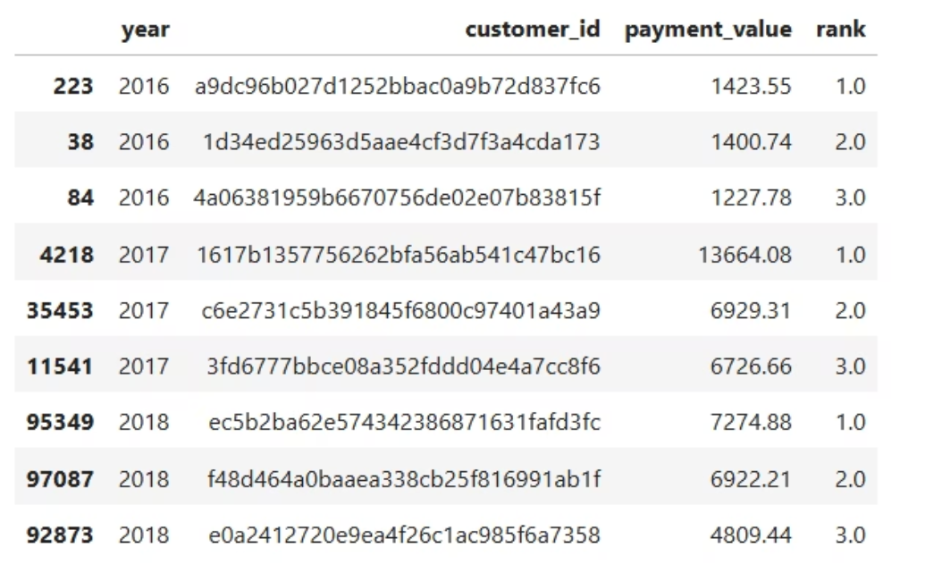
5.Top 3 Customers per Year by Spend
CODE : Python
CODE : SQL
orders['order_purchase_timestaorders['order_purchase_timestamp'] = pd.to_datetime(orders['order_purchase_timestamp'])
orders['year'] = orders['order_purchase_timestamp'].dt.year
df = orders.merge(order_payments, on='order_id', how='left')
spend = ( df.groupby(['year','customer_id'])['payment_value']
.sum()
.reset_index())
spend['rank'] = spend.groupby('year')['payment_value'] \
.rank(method='dense', ascending=False)
top3_customers = spend[spend['rank'] <= 3] \
.sort_values(['year','rank'])top3_customersmp'] = pd.to_datetime(orders['order_purchase_timestamp'])
SELECT *, RANK() OVER (PARTITION BY yr ORDER BY spend DESC) AS rnk FROM yearly_spend)SELECT *FROM rankedWHERE rnk <= 3;

Slide 31

Conclusion
This project successfully demonstrated the comparison of solving identical e-commerce data analysis problems using SQL and Python (Pandas). Both tools proved effective for data manipulation, aggregation, and advanced analytical tasks, while differing in syntax style, flexibility, and execution approach.
SQL showed strong capability in structured querying, joins, and database-level operations, whereas Python provided greater flexibility for data transformation, statistical analysis, and complex logic handling.
Through this comparative approach, the project strengthened practical understanding of when and how to use each technology efficiently. The analysis also highlighted key business insights related to sales trends, customer behavior, and revenue distribution, reinforcing the importance of selecting the right analytical tool based on problem requirements.

